Slide 1

JOBNAVIGO
Presented by:-
Khushi Kadam - 21107031
Shravani Kulkarni - 21107063
Krish Jaswal – 21107039
Vedant Mayekar - 22207007
Project Guide -
Prof. Vaibhav Yavalkar

Slide 2
Introduction:
The Online Job Portal is a user-friendly website designed to connect job seekers with job recruiters providing opportunities
Recruiters have the capability to post job listings according to their specific requirements
An admin oversees the entire system, ensuring data accuracy and maintaining overall control
Problem statement: Overwhelming job and internship search in competitive marketing
Solution proposed: Personalized job matchmaker connecting users to relevant opportunities

Slide 3
Objectives:
Ease the connection between individuals seeking employment opportunities and companies looking to hire
Provide an easy-to-use platform with advanced search and filtering options for job seekers to find relevant job postings
Display latest jobs available to the user
Simplify the process for recruiters to create, edit, and remove job postings while ensuring they contain detailed and accurate information

Slide 4
Scope:
Display accurate list of job openings with basic details such as job title, location and company name
Provide detailed job information that includes a brief description, application deadline, and contact information
Allow users to create profiles with their basic information and a way to apply for jobs according to their preference
To avoid complex features found in comprehensive job search apps

Slide 5
Features:
User-Friendly Interface:
Enable easy job discovery through keywords, location, and filters
Resume & Profile Management:
Allow users to create, edit, and store resumes and profiles for quick job applications
Application Tracking:
Helps recruiters organize interviews and check application statuses
Notifications & Alerts:
Send timely updates, new job listings, and interview invitations
Streamlined Experience:
Enhance the job application process for job seekers and employers

Slide 6
Outcome of the project:
Increased chances of job seekers finding positions that match their career goals
Improved job search experience and user satisfaction
Personalized job suggestions based on a user's skills and qualifications
Potential reduction in the time and effort required for job hunting
Potential cost savings for employers by reducing the need for extensive job advertising.

Slide 7
Technology Stack :
1. FRONT END :-
HTML 5
CSS 4.15
BOOTSTRAP
2. BACK END
Django 4.2.5

Slide 8
Algorithms used:
Genetic Algorithm
Used in the project to evolve personalized job recommendations for users by iteratively selecting and combining job listings based on user preferences and qualifications.
NLP (Natural language processing)
Dialogueflow uses Google’s powerful Natural Language Understanding platform and then tries to understand your language, based on the training you give.

Slide 9
BLOCK DIAGRAM : User
JOBNAVIGO
User login
JOBS
Admin login
Recruiter’s login
All Users
All Recruiters
Add jobs
Job list
Candidates Applied
ACCEPT Candidates
REJECT
Candidates

Slide 10
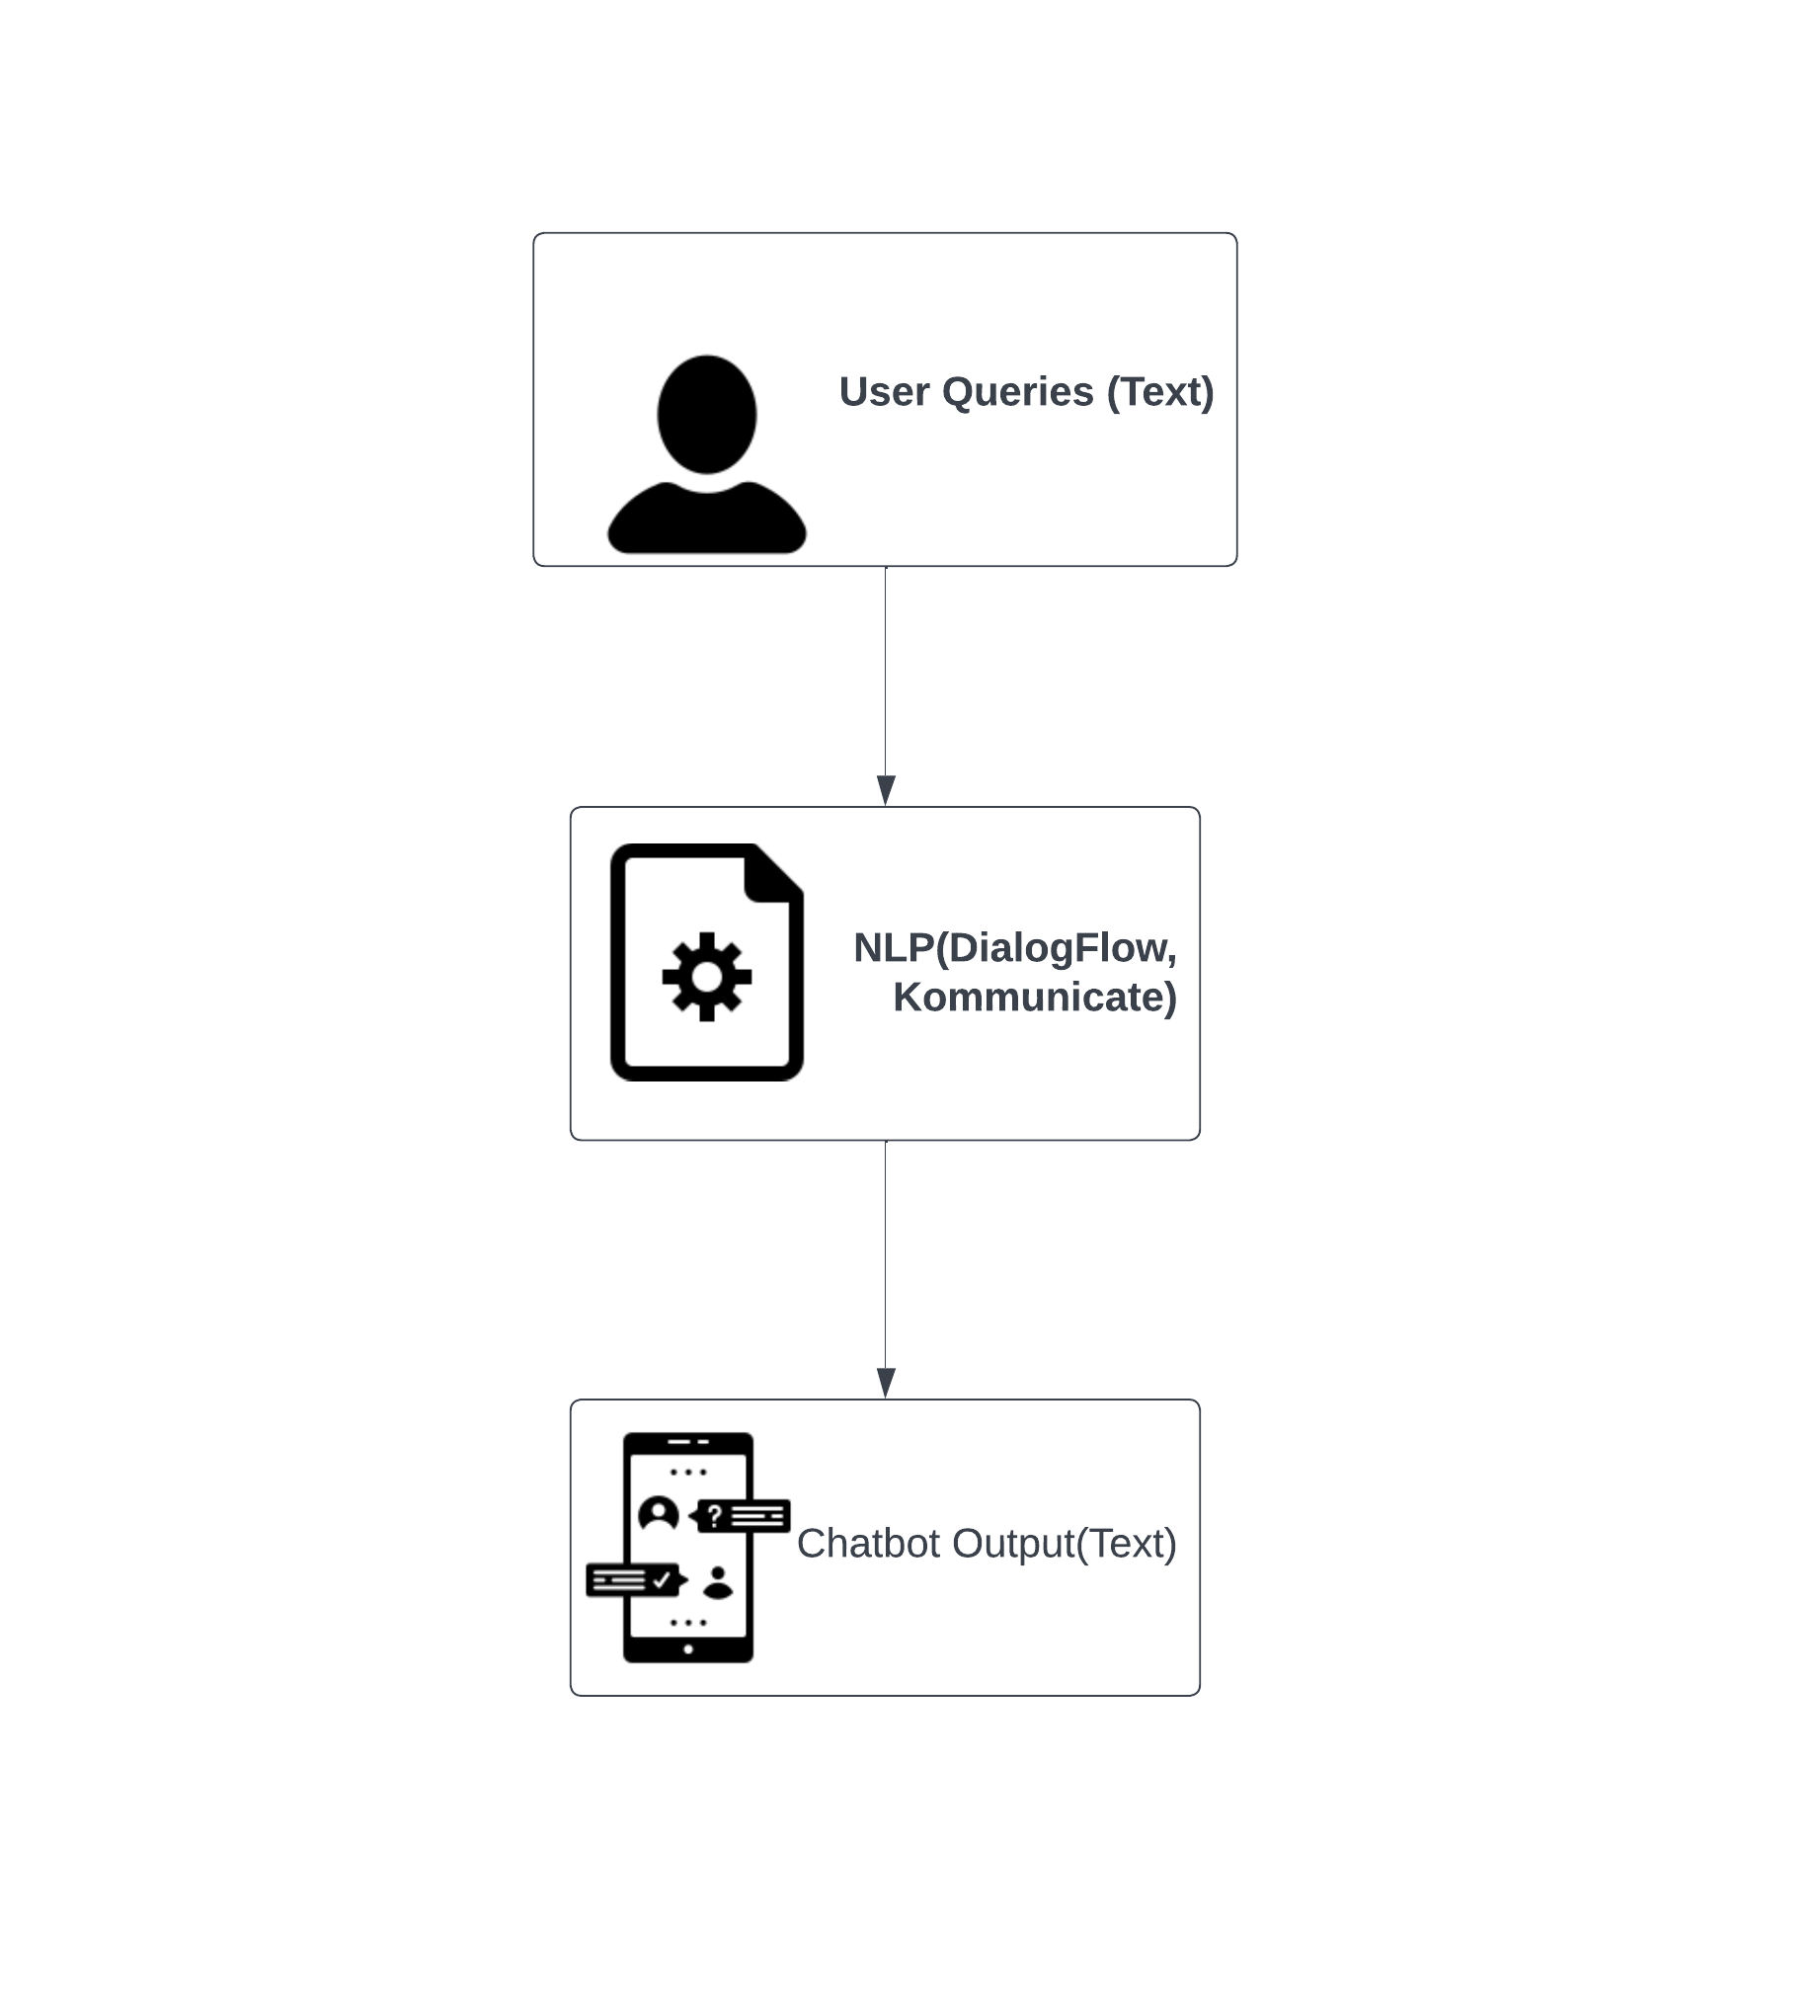
BLOCK DIAGRAM : Chatbot using NLP

Slide 11
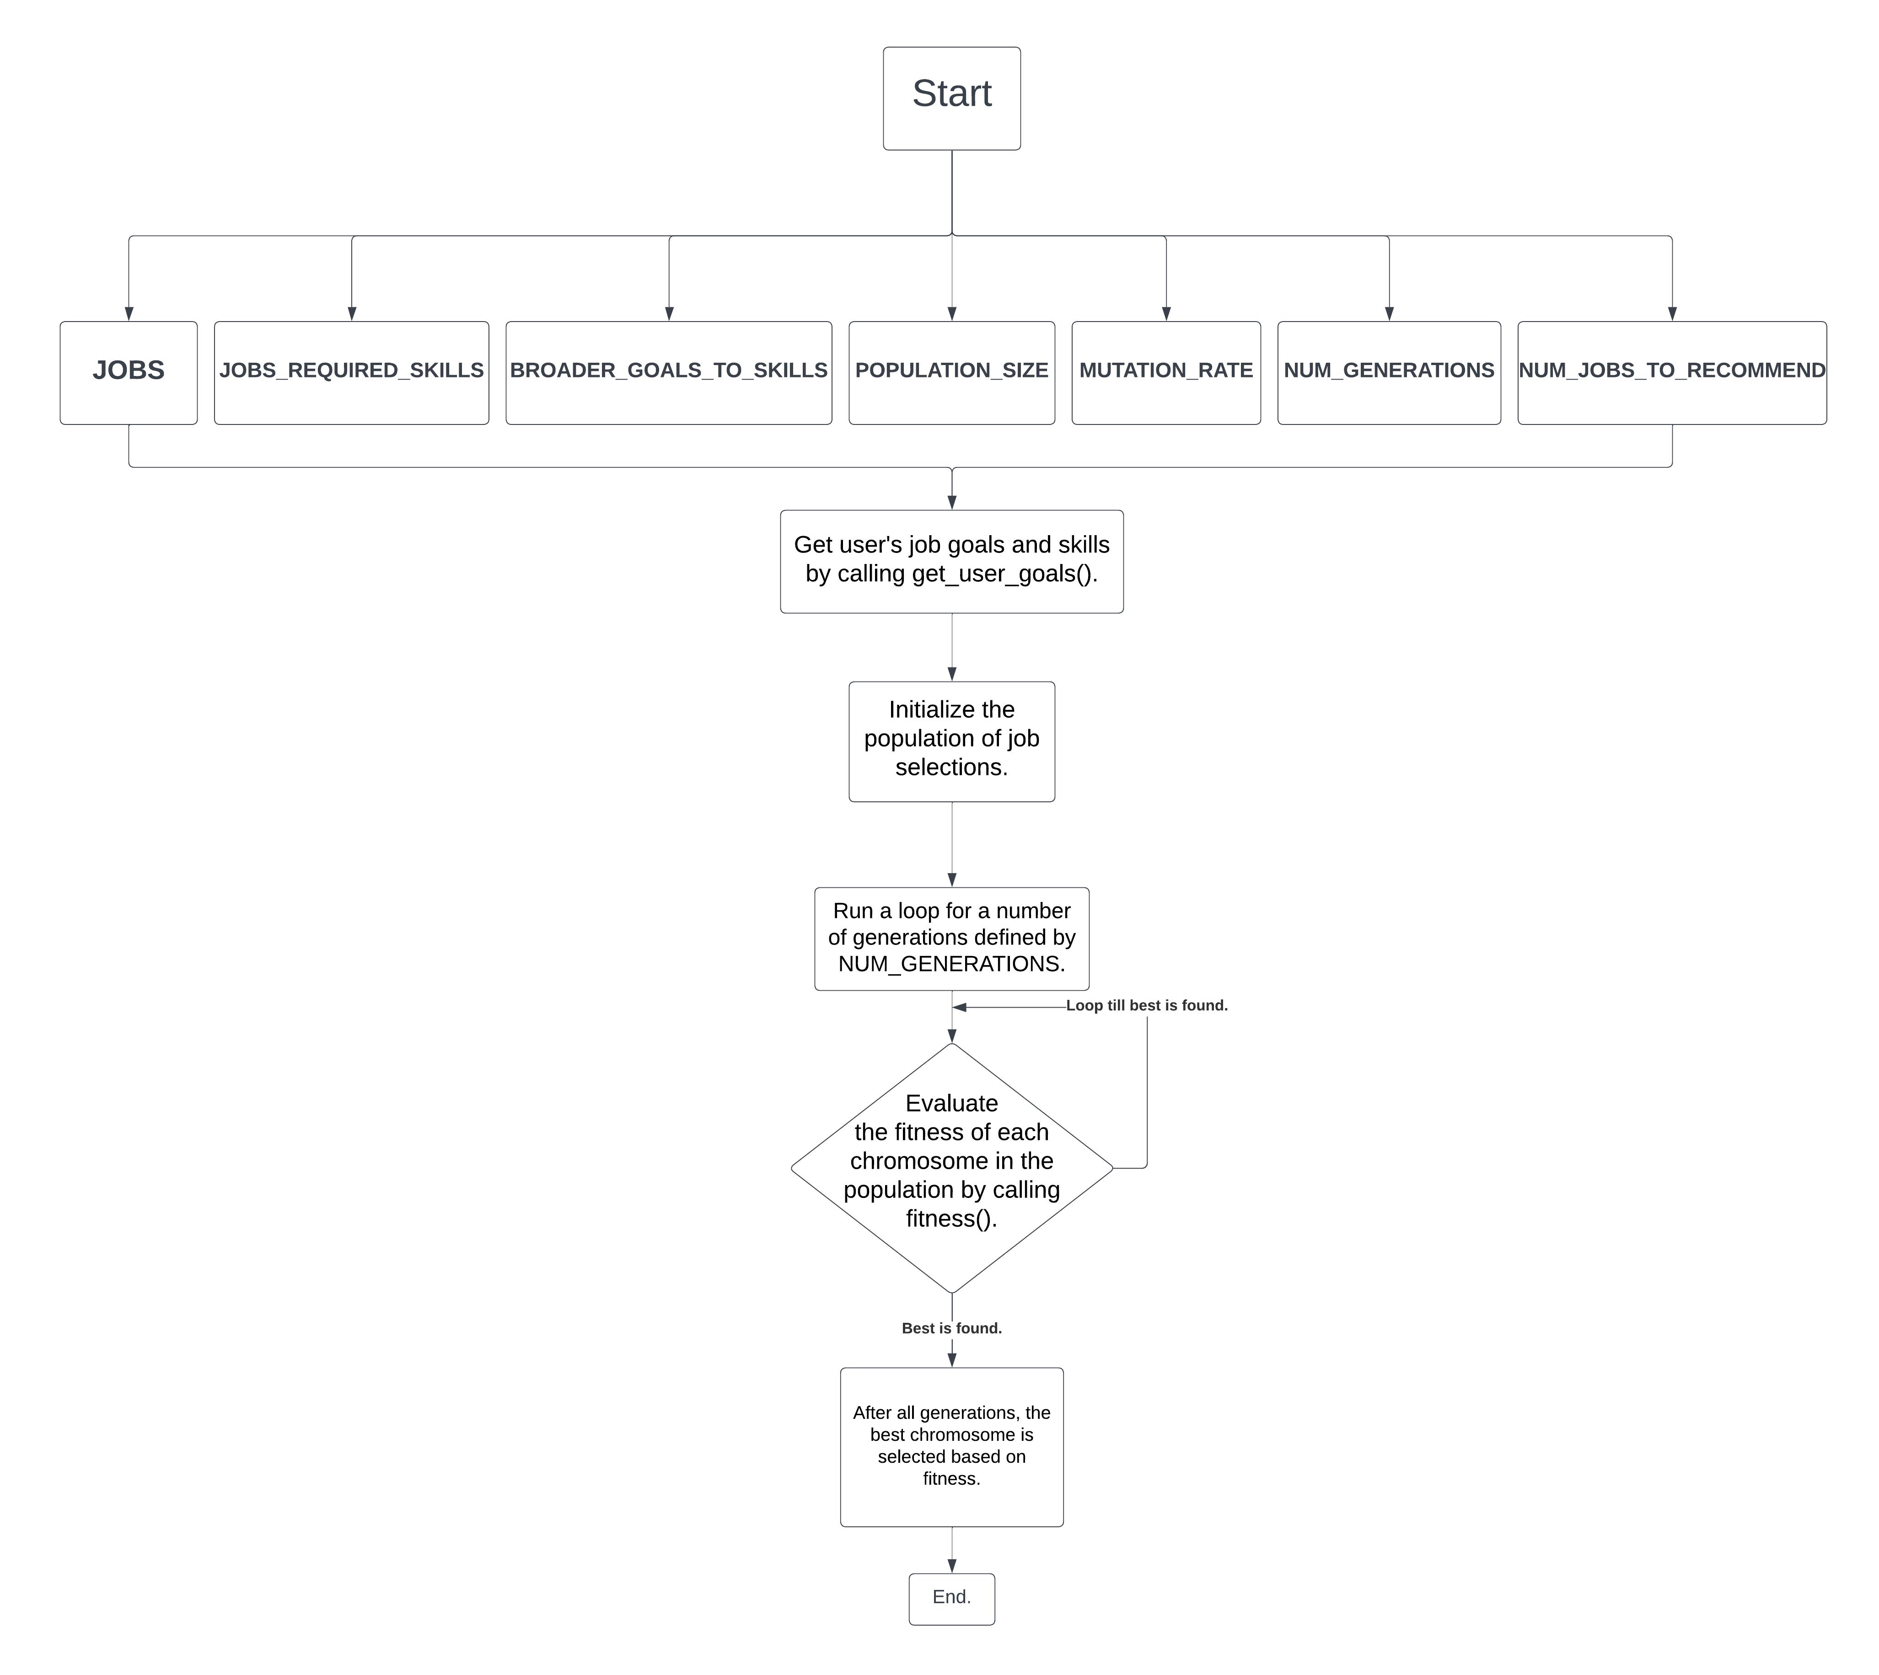
BLOCK DIAGRAM : Genetic Algorithm for recommendation

Slide 12
Thank You...!!

